Slide 1


AutoCAT: Reinforcement Learning for Automated Exploration of Cache-Timing Attacks
Mulong Luo†,∗ Wenjie Xiong‡,◊,∗ Geunbae Lee‡ Yueying Li† Xiaomeng Yang◊
Amy Zhang◊ Yuandong Tian◊ Hsien-Hsin S. Lee^,& G. Edward Suh†,◊
◊ Meta AI, †Cornell University, ^Intel Corp, ‡Virginia Tech,
∗Equal contributions, & work done at Meta AI
The 29th IEEE International Symposium on High-Performance Computer Architecture
Montreal, Quebec, Canada
2023/2/27
Notes:
Hello, everyone. I’ll discuss how reinforcement learning can be used to automatically explore and find cache-timing attacks

Slide 2
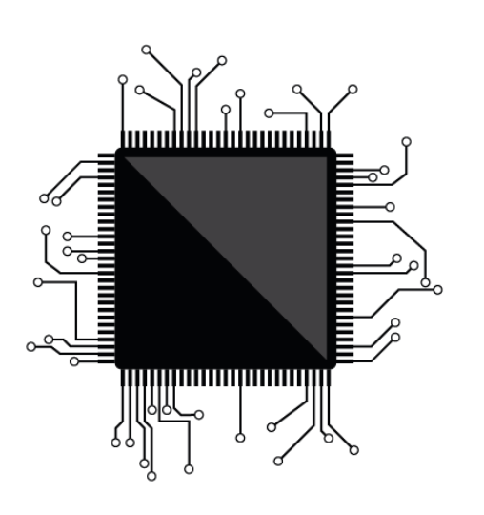

Finding HW Vulnerabilities is Hard
System is too complex
laptop processors have ~ 20,000,000,000 transistors
Undefined system behavior
timing of a memory read is unspecified
speculative execution that are not committed
Humans are slow and make mistakes
can we use machine intelligence to replace them?
A microprocessor
Meltdown/Spectre
Notes:
We are looking at cache-timing attacks, which at high-level is a HW vulnerability. Finding HW vulnerabilities is Hard in general. There are several reasons for this, first, the system is very complex, the latest computer chip has twenty billion transistors and it is hard to make them correct.
Even if every thing is is expected, there are still undefined system behavior which causes vulnerabilities. For example, the timing of a load or store operation is not accurately defined, this undefined behavior causes cache-timing channels. Similarly, the previous reported Spectre vulnerabilities are also due to the undefined behavior of the speculative executions.
Besides, even if everything is well defined, in many cases, we still leverage human intelligence to check for potential vulnerabilities, which is slow and error-prone. As a result, the Spectre vulnerabilities are not reported until early 2018.
So how do we overcome these to find HW vulnerabilities? We are thinking about using machine intelligence to replace human intelligence to achieve that.

Slide 3

Executive Summary
Is there a vulnerability inside?
Agent
Reinforcement learning (RL) can explore cache-timing attacks in processors automatically
without explicit specification of processors
without knowing existing attack sequences
RL finds attacks
on diverse configurations of caches
on real hardware
discovers new attack patterns
Environment
Reinforcement learning scheme
Attack a processor
Notes:
Specifically, We use reinforcement learning, or RL for short, to explore cache-timing attacks in processors automatically, which is a type of HW vulnerability.
Here means we do not need explicit specification of processors, and we do not need to start from existing known attack sequences.
Using RL, we are able to find attacks on diverse configurations of caches. On real hardware, and are able to discover new attack patterns.
Let’s see how we have achieve this.

Slide 4
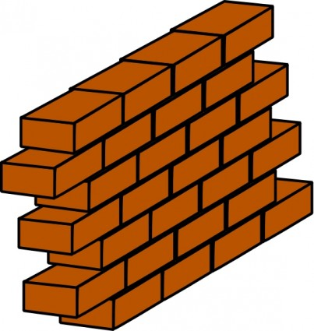
Cache-Timing Attack: Powerful and Stealthy
VM Isolation
Victim
VM
Attacker
VM
Core
L1
Core
L1
Core
L1
Core
L1
0 1
Shared LLC
Mechanism
sharing of caches by different processes
infer secret by observing cache timing
Advantages
attacker is just a program, no physical access
does not violate any OS-level access control
Leak important assets
cryptographic keys
VM/browser isolation
building blocks for Spectre/Meltdown
h = array[secret*4096];
Processor
Memory
Process 1
P1
Process 2
P2
Cache
VM Isolation
Victim VM
Attacker VM
Core L1
Core L1
Core L1
Core L1
Shared LLC
Notes:
First, let’s start with a brief introduction about cache-timing attack, which is a powerful but stealthy attack.
The way cache timing attack work is pretty simple. It requires sharing of caches by different processes. one process can infer the access of another process through timing, or hit or miss of the cache. For example, by observing which cache lien is miss, we can infer the value of the secret.
This sounds really straight forward, but it is a powerful and stealthy attack
This is because the attackers is just a program with out physical access, and it does nor violate any OS-level access control. Thus, it has been demonstrated to leak many important assets, such as cyrpto keys, break VM and browser isolatio, besides, it is the building block for the important spectre/meltdown vulnerabilities.

Slide 5
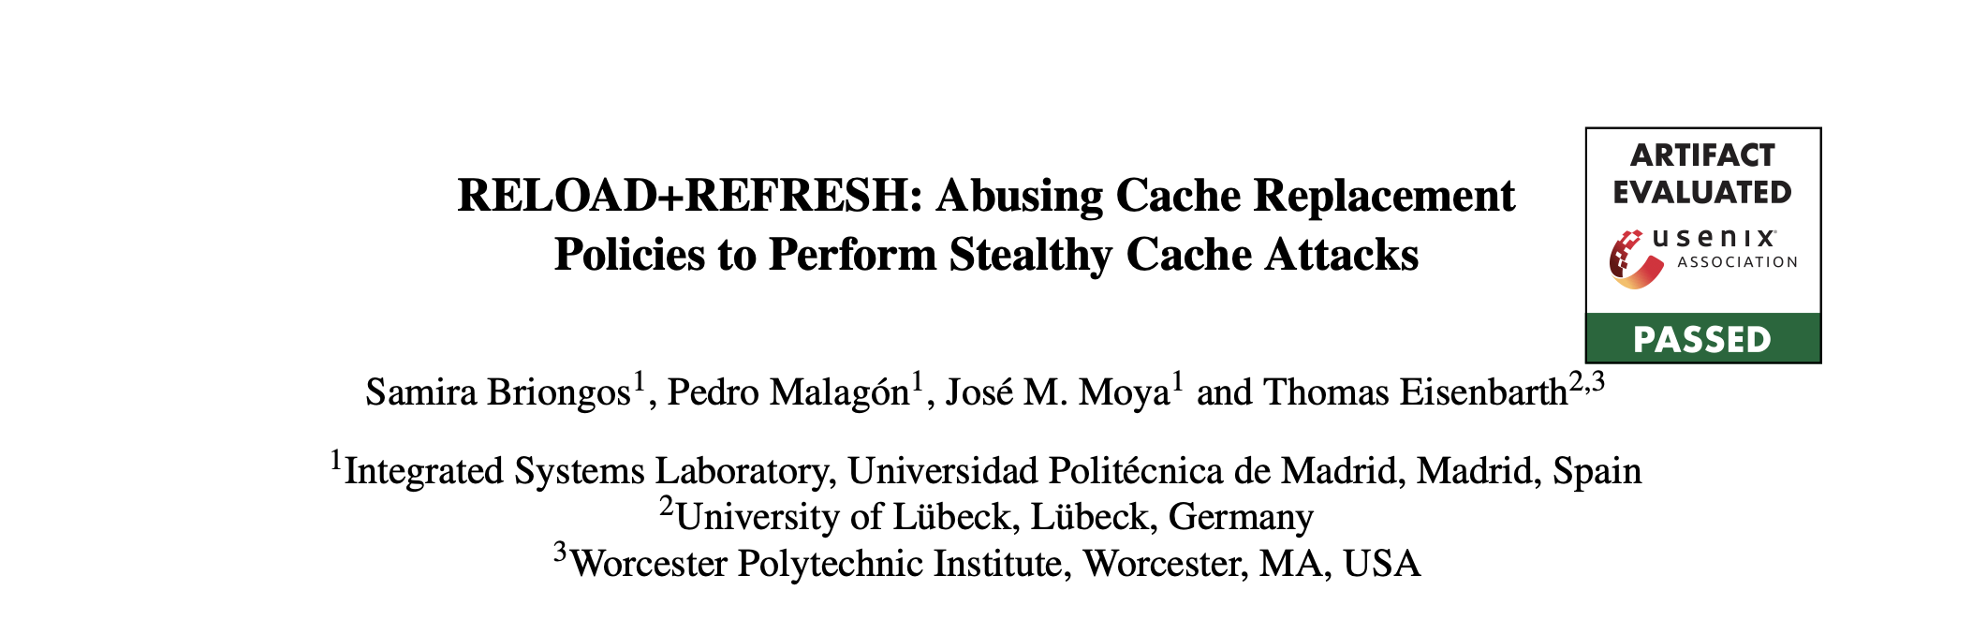
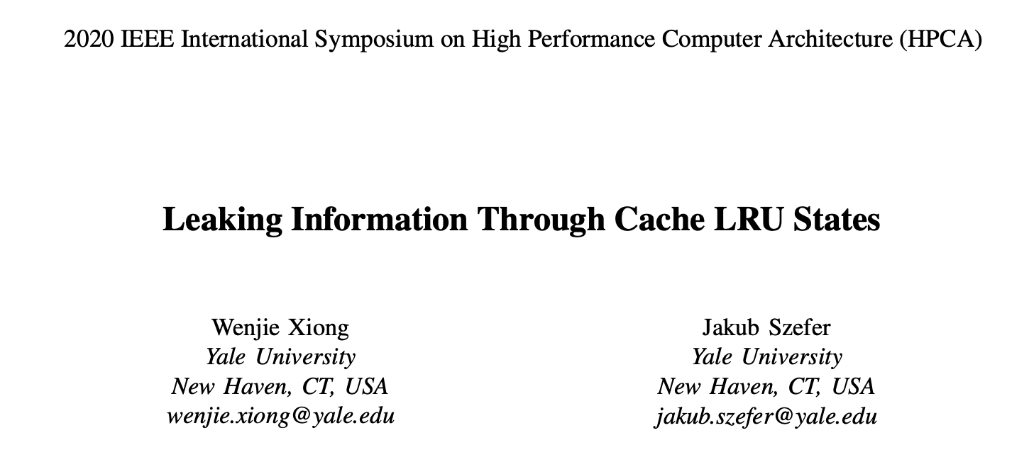
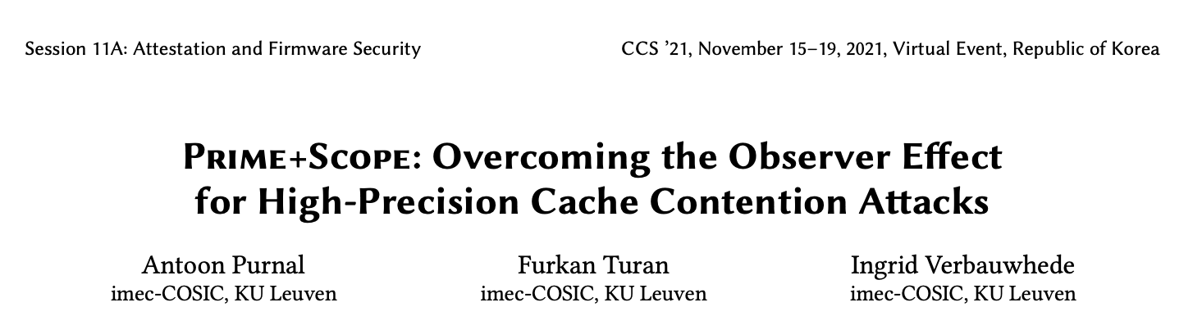
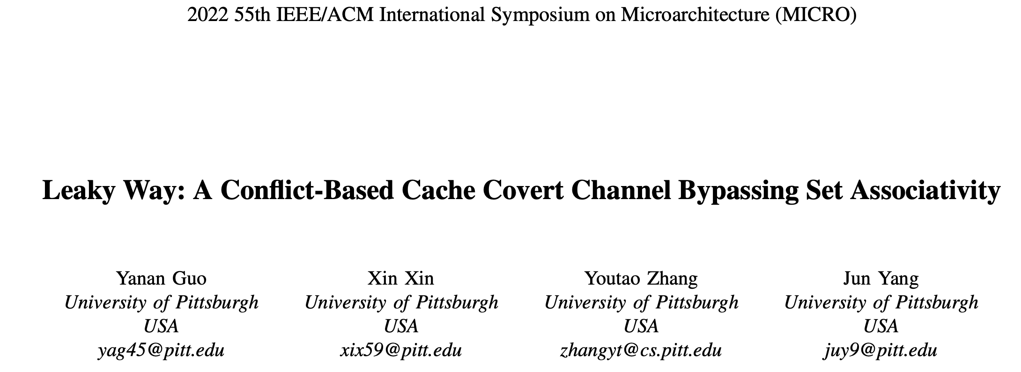
Why Finding new Cache-Timing Attack is Hard?
Cache-timing attack is still developing
Traditional: prime+probe, flush+reload, evict+reload, etc
Finding cache-timing attack is challenging
replacement policy complications
unknown microarchitectural states
…
CH1: Which one will be replaced?
CH3: hit or miss?
Processor
Memory
Process 1
P1
0
1
2
5 cycles (hit)
Process 2
P2
8 cycles (hit)
20 cycles (miss)
Cache
set
h = array[secret*4096];
509
510
511
15 cycles (???)
11 cycles (hit)
6 cycles (hit)
P1 fills the cache
P2 reads an array
P1 reads its data again
CH2: this will be detected!
Notes:
However, finding effective cache timing attack is hard. Traditionally we have prime+probe, evict+reload, etc vulnerabilities. But recently, there are many new types of cache timing attacks which causes new vulnerabilities,
For example, in 2020 we have seen LRU attack and REFRESH+RELOAD, in 2021, we have seen prime+scope, and in 2022 we have seen Leaky Way.
Most of these are found based on human experts. However, finding cache-timing attack by human is very challenging:
Here are some of the typical challenges:
First, the replacement policy complicates the attack.
Send, there are unknown microarchitectural states, which is not easily observation.
These are just some of the challenges . And solely replying on human expertise is not enough, so there are tools to help us.

Slide 6
Existing Tools to Find Vulnerabilities
Fuzzing
pros:
require fewer human interventions
con:
have to deal with large search space
Formal methods
pros:
can provably exclude possible vulnerabilities/attacks
cons:
require RTL of the processor
require human to rewrite/implement the formal models
Notes:
There are exising tools findings vulnerability in hardware including cache timing attacks and more recently the speculative execution attacks.
First category is fuzzing, the idea is randomly generating the attack sequence and check whether there is a leakage. It does not require the RTL of the processor or human knowledge, but it does to deal with very large search space.
The second category is formal method, they provide theoretical guarantee whether the processor is leakage free. However, they generally require the RTL of the processor, and the RTL has to be processed by humans to annotate or convert to a formal model, which is still error prone.
So we do not want too much human interventions, we do have RTL and we want more efficient way, what do we do? As mentioned earlier, we use reinforcement learning.

Slide 7
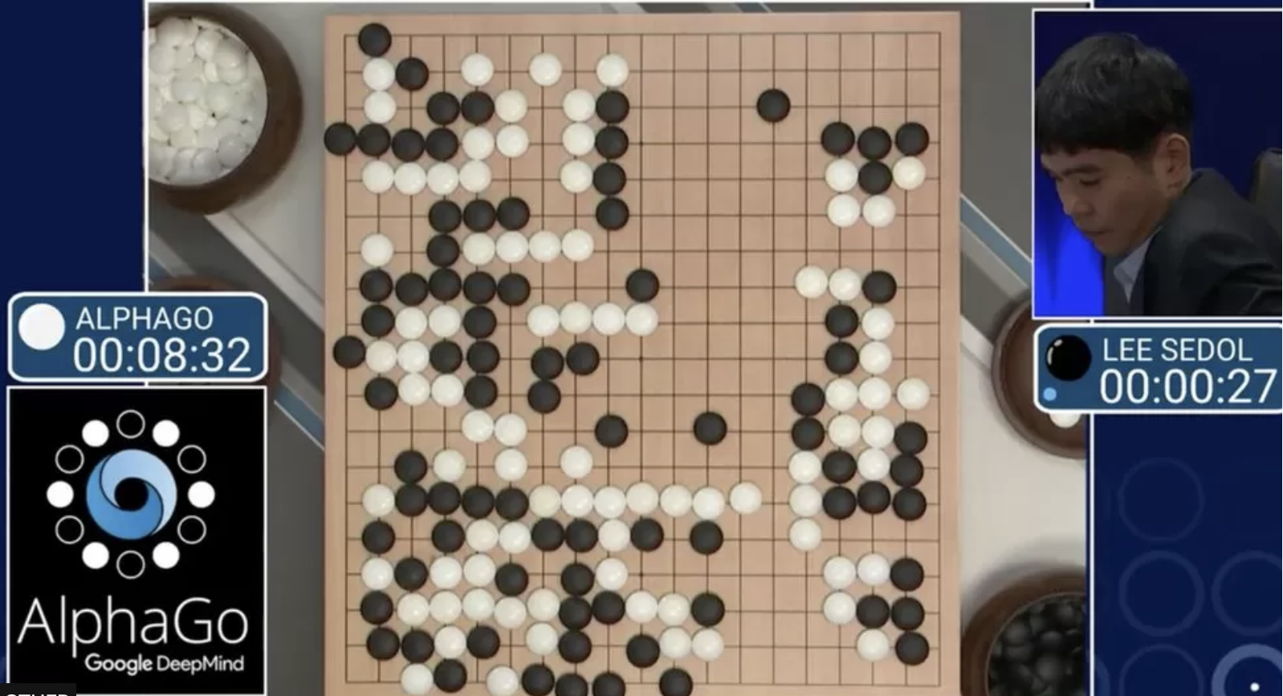

Reinforcement Learning
RL: a machine learning scheme
an agent generates an action sequence
maximizes long-term reward
RL has been applied in game settings to show human-level performance
games like Atari (single party)
Chess, Go, etc. (two parties)
AlphaGo (Source: BBC)
Atari (source: OpenAI)
Notes:
If you have ever heard about alphaGo or Atarti, then you should know that RL plays a important role there.
Reinforcemtn learning is a machine learning scheme in which an agetnt generates an action sequence, to maximize the long-term reward
It has been applied in the game settings to show human-level performance.
For example, video games like Atari or go and chess games.

Slide 8
Reinforcement Learning
Key notions
agent
environment (env)
action
observation
reward
Advantages of RL
learns a sequence of actions → cache-timing attack is a sequence
no dataset needed, just an env → a simulator/a real processor
Agent
Action
Reward
Observation
Environment
Sequence of actions
Notes:
Here we are showing the key notions in reinforcement learning.
There are agents, which is similar to a game player. There environments which you can think as the game itself. The agent takes actions to the environment, and the environment gives observations and rewards to the agent, so that the agent will learn what action to take.
Two advantage of RL makes it very suitable for exploring cache-timing attacks
RL can learn a sequence of actions with varying length, Cache-timing attack is also a sequence of memory accesses, thus, RL naturally fits here.
It does not require a dataset, everything is generated by RL environment. As computer architect, it is easy for us to pick an architecture simulator or a processor as the environment.
As a result, if we can formulate it as an RL problem, RL will be a good fit to explore cache-timing attack

Slide 9
Outline
RL formulation of cache-timing attack exploration
RL finds attacks on diverse configurations of caches
RL finds attacks on real-hardware
RL discovers new attack patterns
Notes:
Let’s how excactly we formulate cahc-timing exploration as an RL problem

Slide 10
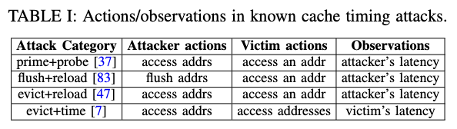
Cache-Timing Attack as an RL Game
Action
Agent: Attacker
Environment: Cache
architecture simulator
cache in the processor
Actions
attacker makes an access
attacker waits for victim access
attacker guesses the secret
Observation
latency of attacker accesses
Agent
Reward
Environment
Observation
Summary of actions of existing attacks
Attacks | Attacker action | Victim action | Observations
prime+probe | access addrs | access an addr | attacker’s latency
flush+reload | flush addrs | access an addr | attacker’s latency
evict+reload | access addrs | access an addr | attacker’s latency
evict+time | access addrs | access addrs | victim’s latency
Notes:
So in this RL formulation
the agent is the attacker
And the environment is the cache, it can either be an arhcitcute simulator a a cache in the real processor
In terms of how to define the action and observations space, let’s see some of existing attacks, listed in this table.
From the table we can summarize the type of actions and the observation needed.
We define three type of actions
attack makes an access
wait for victim access
guess the secret
And the observation is the latency of an attack access
Besides, we also have to define the rewards

Slide 11
Cache-Timing Attack as a Game
Action
Reward
guess correct: positive reward
guess wrong: negative reward
each step: small negative reward
Maximizing long-term reward
more correct guesses
fewer wrong guesses
fewer number of steps
Agent
Reward
Environment
Observation
Summary of actions of existing attacks
Attacks | Attacker action | Victim action | Observations
prime+probe | access addrs | access an addr | attacker’s latency
flush+reload | flush addrs | access an addr | attacker’s latency
evict+reload | access addrs | access an addr | attacker’s latency
evict+time | access addrs | access addrs | victim’s latency
Notes:
We want the agent to make correct guess, so we give positive reward when the guess is correct
We give netage reward when the guess is wrong, and for each step we give small negative reward
As mentioned, RL maxixmizes long-term reward
Thus, this reward setting will encourage more correct guesses, less wrong guesses, and less number of steps.

Slide 12
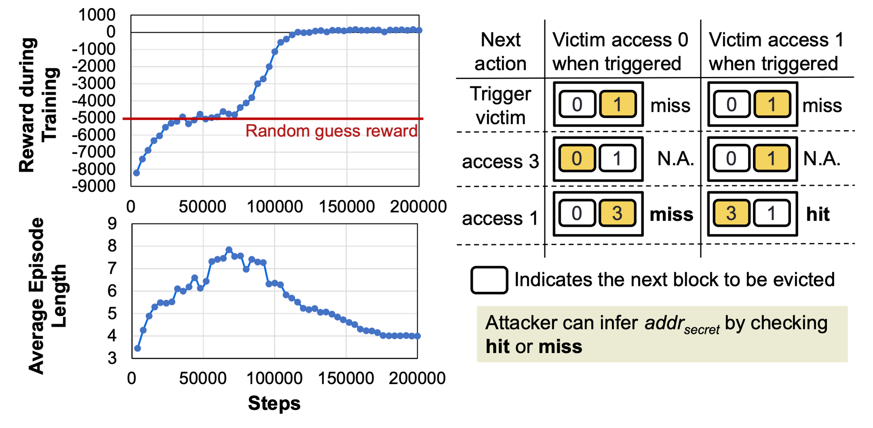
AutoCAT: A Simple Example
Victim address
Attacker address
Settings
1 set 1-way cache
attacker can access address 1
victim secret: access 0 (0) / no access (N)
attacker want to infer whether victim secret is 0/N
Attack found
step 1: attacker accesses 1
step 2: then wait for a while
step 3: attacker accesses 1 again
step 4: guess the secret 0/N
0
1
Cache
Correct guess reward
wrong guess reward
0
1
2
5 cycles (hit)
8 cycles (hit)
set
509
510
511
15 cycles (???)
11 cycles (hit)
6 cycles (hit)
P1 fills the cache
P2 reads an array
P1 reads its data again
Notes:
Let’s see a simple example how this RL formulation can work
The setting is a 1-way cache and attacker can access address 1
Victim can access 0 or no access
The attacker wants to find out whether the victim access 0 or not
So we use RL training and we show the reward during training on the right.
At first the reward is very low, then it increases, which corresponds to random guess reward
In the end, the reward gets positive
Here we show what the attack found by RL looks like
First, the attacker accesses address 1
Then, the wait for a while when the victim make access
After that, the attackder accesses 1 again, depending on whther it is hit or miss, if can infer whether the victim has made an access.
This is a typical prime and probe attack for this case。
h

Slide 13








AutoCAT: Framework Overview
Cache Simulator
Real Hardware
Observed memory access latency
or
attacker
& victim
config
RL Agent
Environment
Target cache implementation
a1: attacker
access
attacker process
read/
write/
flush
AutoCAT RL Engine
a2: trigger victim
access
Cache Interface
State
victim process
Cache Interface
Action
Cache Implementation
Attack Sequence Generation
RL training
addr_{secret}
a3: guess
addr_{secret}
time
Attack Sequence (trajectory of actions)
DNN Model
guess evaluator
Attack Analysis
Attack Demonstration on Real Hardware
Reward
AutoCAT RL Engine
Notes:
Here we see the entire AutoCAT framework. On the left, everything is feed into the AutoCAT RL eggine. Including the cache implementation (could be either a cache simularot or a real hardware), we also need attacker and victim configarion to config the RL engine. The RL engine is also shown on the right which shows the environment and the agent controlled by a DNN model.
The result of the training is an attack sequence. (or in RL terminology, a trajectory of actions), they can be further analyzed or demonstrated on real hardware if the result is generated by the cache simulator.

Slide 14
Outline
RL formulation of cache-timing attack exploration
RL finds attacks on diverse configurations of caches
RL finds attacks on real-hardware
RL discovers new attack patterns
Notes:
Using this framwork , we can find attacks on diverse configurations of caches

Slide 15
AutoCAT: Attacks on Diverse Configurations
Number of sets/ways
Type of caches
direct-map/fully-associative/set-associative
Replacement policies
least recently used (LRU)/re-reference interval prediction (RRIP)
Prefetchers
none/stream/nextline
Single-level/multi-level
0
1
2
set
509
510
511
0
1
2
3
4
5
6
7
way
Notes:
We have tested autocrat on a diverse configurations
By changing the number of sets/ways
The type of caches
And the replacement policies
Different prefetchers

Slide 16
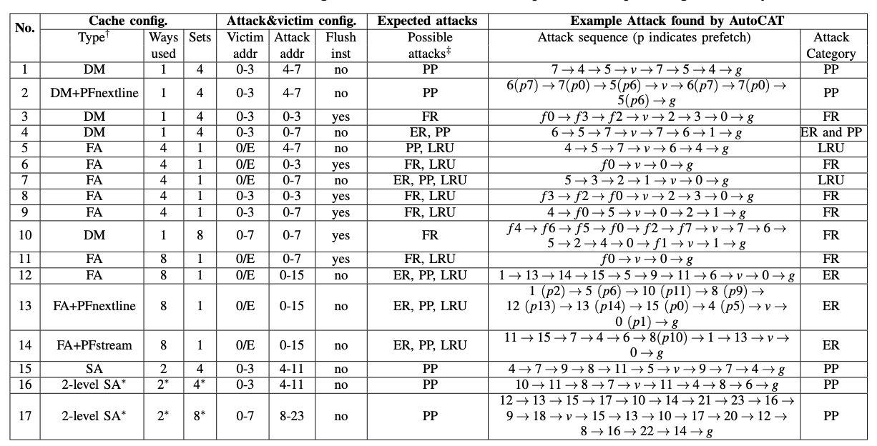
AutoCAT: Attacks in Simulator
Find attack patterns across 17 different configurations (No. 1-17)
including direct-map, fully-associative, prefetchers, 2-level caches
Excerpts from Table IV in the paper
No | Type | Ways | Sets | Victim address | Attacker address | Accuracy
1 | Direct-map | 1 | 4 | 0-3 | 4-7 | 100%
4 | Fully-associative | 4 | 1 | 0/E | 4-7 | 100%
13 | Fully-associative+nextline | 8 | 1 | 0/E | 0-15 | 100%
16 | 2-level | 2 | 4 | 0-3 | 4-11 | 100%
Configurations
AutoCAT found attack sequences
Notes:
Here we show the results . We have demonstrated 17 different configurations and autocat find the attack sequences corresponding to each of these.
When evaluating accuracy, for each configuration we tested 1000 times.

Slide 17
Outline
RL formulation of cache-timing attack exploration
RL finds attacks on diverse configurations of caches
RL finds attacks on real-hardware
RL discovers new attack patterns
Notes:
Let’s see what we found on real hardware

Slide 18
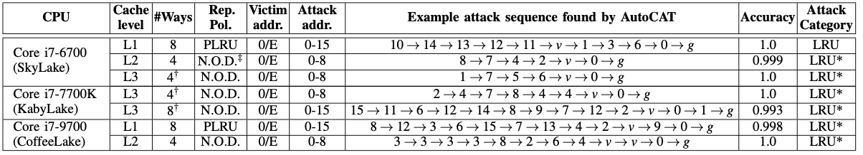
AutoCAT: Real Hardware
AutoCAT finds attacks without knowing the replacement policy
CPU | Level | Ways | Rep policy | Accuracy
Core i7-6700 | L1 | 8 | PLRU | 100%
Core i7-6700 | L2 | 4 | Undocumented | 99.9%
Core i7-6700 | L3 | 4 | Undocumented | 100%
Core i7-7700K | L3 | 4 | Undocumented | 100%
Core i7-7700K | L3 | 8 | Undocumented | 99.3%
Core i7-9700 | L1 | 8 | PLRU | 99.8%
Core i7-9700 | L2 | 4 | Undocumented | 100%
Notes:
For the real hardware, we have also tested three different processors that are available within our university with different levels, and we have found all the corresponding attack sequences with almost 100% accuracy.
(Real-Hardware processors have multiple levels
Each level adopts different replacement policy
AutoCAT find attacks without knowing the replacement policy

Slide 19
Outline
RL formulation of cache-timing attack exploration
RL finds attacks on diverse configurations of caches
RL finds attacks on real-hardware
RL discovers new attack patterns
Notes:
Let’s see the new attack pattern we found

Slide 20
AutoCAT: A New Attack Pattern
Setting:
4-way cache
victim secret address from 0, 1, 2, 3
Attack pattern:
attacker accesses 0, 1, 2, 3 first
victim accesses the secret address (always a hit)
attacker accesses 4, 0, 1, measure the timing of 0 and 1
depending on 0,1 hit/miss can infer the victim secret address
LRU addr-based
(v==0?)
LRU addr-based
(v==1?)
LRU addr-based
(v==2?)
…
loop
…
LRU addr-based
(v==3?)
4
0 | 1 | 2 | 3 | v? | 4
0 | 1
Notes:
Here we show how the access patter, so victim secret is either 0,1,2,3. and 0,1,2,3 is accessed first, thues victim is always a hit. However, when 4 is accessed, depending on what victim address is, the attack hit or miss after that will be different. Thus, it will be able to infer the victim addree. We call this new attack stealthyStreamline attack

Slide 21
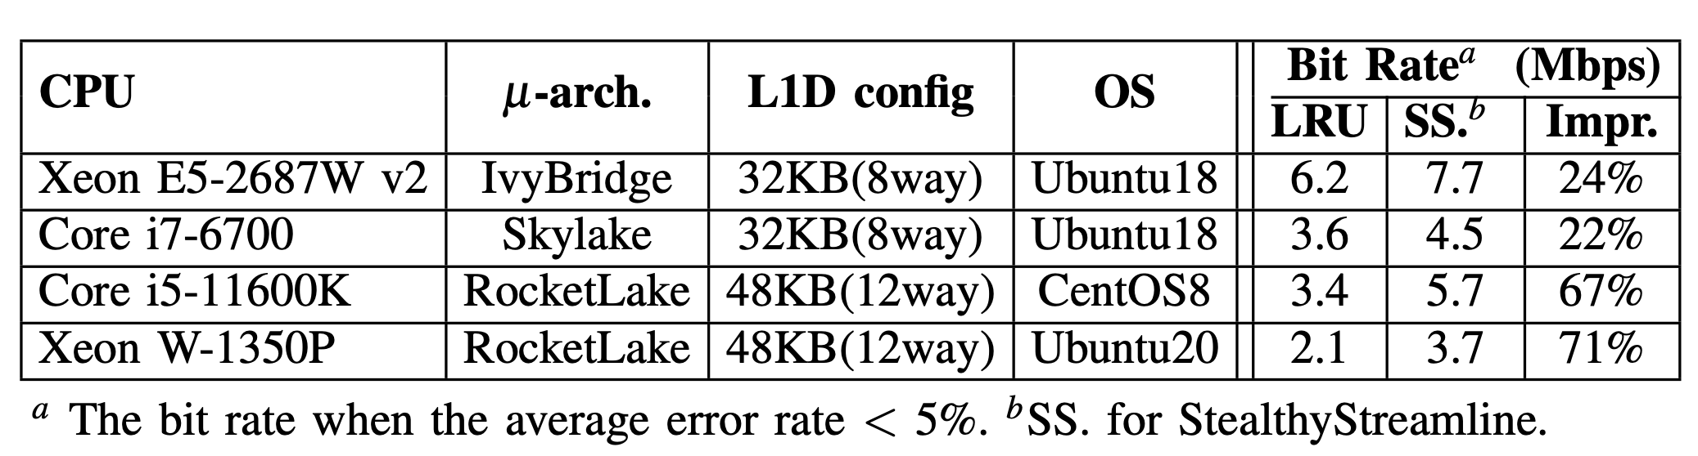
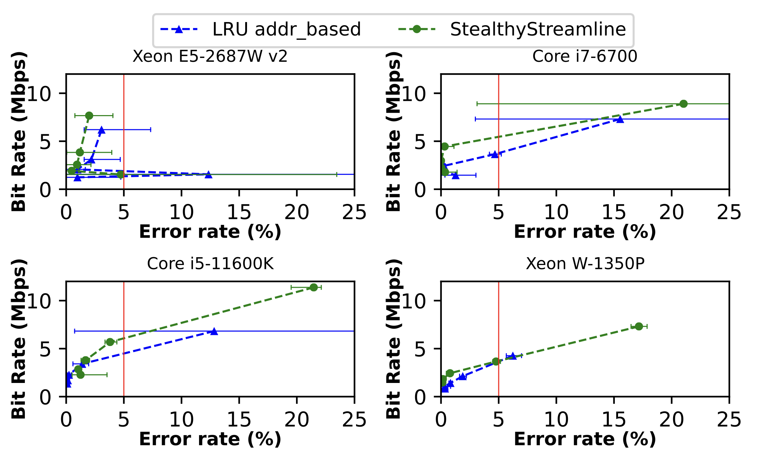
New Attack Pattern: StealthyStreamline
No victim cache misses
Works across different processors
4 different Xeon/Core processor tested
Higher bandwidth than the LRU-based attack
StealthyStreamline bandwidth and error rate (top-left corner is better)
Notes:
The stealthyStreamline attack a works across differen processors as shown here. Where we plot the error rate and bit rate of the attack. The blue one is the previous state-of-the-art LRU address based attack, while the green is the StealthyStreamline attack. We see that staelhtystramline has higher bit rate when the erro rate is the same.

Slide 22
More in the Paper
Bypassing defense and detection techniques
partition-locked (PL) cache
autocorrelation-based detection similar to CC-Hunter [MICRO14]
ML-based detection similar to Cyclone [MICRO19]
Discussions
comparison with search algorithms
less number of steps compared with exhaustive search
future extensions
automated attack analysis
scalability of the RL model
Notes:
Due to time limit, there are things we do not discuss here but are included in the paper

Slide 23



Conclusion
AutoCAT uses RL to explore cache-timing attacks in processors
without explicit specification of processor design
without knowing existing attack patterns
AutoCAT found attack patterns
on many configurations in the cache simulator/real hardware
a new attack pattern: StealthyStreamline
Artifact available at: https://github.com/facebookresearch/AutoCAT
A tutorial session (RL4CAS) including AutoCAT usage will be held at ISCA2023
https://rl4cas.github.io
Notes:
So in conclusion, in this work
We use RL to explore side channel attacks in processors
We explore attacks on many configurations, defense mechanisms
We discover new StealthyStreamline attack
The artifact of autocat is available here.

Slide 24




Introduction: Cybersecurity
Vulnerability is everywhere
Stuxnet: nuclear power plant
Cambridge Analytica: social networks
Log4j: web infrastructure
Spectre/Meltdown: computer hardware
Huge dollars spent
2.5 trillion USD = GDP of UK (5th largest country)
finding and resolving vulnerabilities
Source: fair institute

Slide 25
Cache Defense Mechanism
0
1
2
5 cycles (hit)
Partition
Attacker process and victim process uses their own cache lines without sharing with the others
E.g., PLCache
Example: 4-way PLCache
Way 0: victim process exclusive
Way 1-3: attacker process exclusive
Can AutoCAT find attacks on PLCache?
6 cycles (hit)
5 cycles (hit)
set
509
510
511
5 cycles (hit)
5 cycles (hit)
6 cycles (hit)
P1 fills the cache→ a1
P2 reads an array → a2
P1 reads its data again→ a1
Way 0
Way 1
Way 2
Way 3
Used by victim process
Used by attacker process

Slide 26
AutoCAT’s Attack on PLCache
Victim access 0 when triggered
Victim no access when triggered
Next action
hit
hit
1
0
1
1
0
0
1
0
access 1
2
2
3
3
2
2
3
3
Trigger victim
N.A.
0
1
3
N.A.
0
1
3
0
1
0
1
2
2
2
2
2
2
2
2
3
access 3
miss
miss
1
0
1
3
2
1
3
2
0
0
1
0
2
2
2
2
2
2
2
2
access 3
hit
hit
1
3
2
0
1
3
2
0
1
3
0
1
3
0
2
2
0
2
2
2
0
2
access 2
miss
miss
0
1
3
0
1
3
2
0
1
3
2
0
1
3
2
0
0
2
2
0
0
2
access 5
miss
miss
0
1
3
2
1
3
2
0
1
3
2
0
1
3
2
0
0
0
0
2
2
0
0
2
access 5
hit
miss
4
1
3
2
0
1
3
4
0
1
3
2
0
5
3
2
1
2
1
1
LRU addr 1 not locked, can be replaced
LRU addr 0 locked, cannot be replaced
Sfds

Slide 27
Cache Timing Attack Detection
The cache access pattern by the attacker have specific characteristics
0 1
0
1
2
set
509
510
511
P1 fills the cache
P2 reads an array
P1 reads the cache
P2 reads an array
P1 reads the cache
P2 reads an array
P1 reads the cache
Steps
Replacement events
none
replace
replace
replace
replace
replace
replace
Event encoding
0
1
0
1
0
1

Slide 28
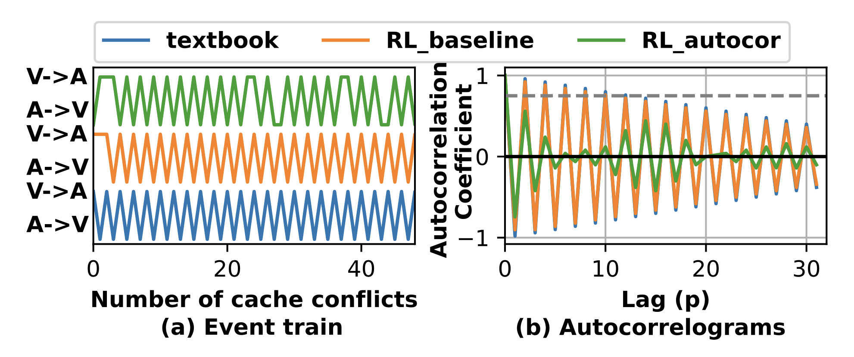
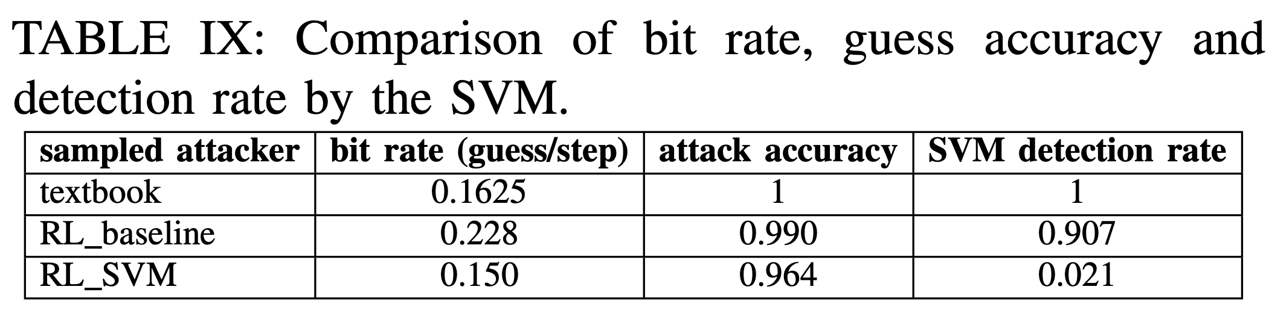
AutoCAT can Bypass the Detection
AutoCAT can generate attacks that bypass CC-Hunter
Textbook: prime+probe
RL_baseline: training without considering the CCHunter
RL_autocor: training with consider high autocor as penalty
AutoCAT can generate attacks that evade SVM detection
RL_SVM: training with considering SVM detection penalty

Slide 29
AutoCAT: A Simple Example
Victim addresses
Attacker addresses
Settings
1 set 2 way cache LRU policy
Attacker can access address 0, 1, 2, 3
Victim can access 0 or 1
Attacker want to infer whether victim accesses 0 or 1
Reward
Correct guess: 200
Wrong guess: -10,000
0
1
2
3
0
1
cache
hit
hit
0
1
2
5 cycles (hit)
8 cycles (hit)
set
509
510
511
15 cycles (???)
11 cycles (hit)
6 cycles (hit)
P1 fills the cache
P2 reads an array
P1 reads its data again

Slide 30
Covert and Side Channels
Computation affects the physical world, and an observer can measure physical effects
Confidential information may leak through physical properties not intended for communications
Timing, power consumption, EM, temperature, acoustic, etc.
Covert channels
Use unintended physical properties to transmit information without the authorization or knowledge of a system
Side channels
Unintentional covert channels

Slide 31
Timing Channel Protection
Completely remove timing dependence
Secure, but expensive
More empirical protection
Reduce the timing dependence (noise, coarser-grained resource allocation, etc)
Detect an attack
Less expensive, but difficult to provide a security guarantee
Use ML to automatically generate attacks?
A game between an attacker and a defender

Slide 32
Side-Channel Attack: An Example
Infer secret information from target device by observing power consumption
Threat models require physical access or proximity to device
Source: Cryptography Research
Source: Wikipedia

Slide 33
Cache Timing Attack Detection
events
CC-Hunter: calculate the autocorrelation of eviction encode
High autocorrelation → likely an attack
Low autocorrelation → likely a benign program
Cyclone
Use SVM classifier to detect an attack
A→ V
V→ A
time
Eviction events
1
autocor
Time lag
-1
autocorrelation

Slide 34
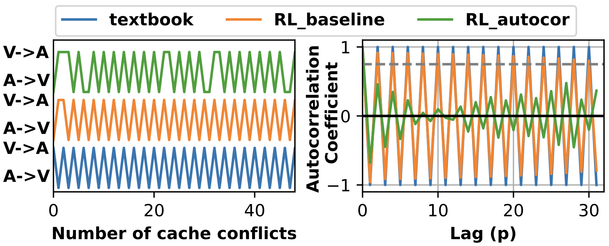
AutoCAT can Bypass the Detection
AutoCAT can generate attacks that bypass CC-Hunter
Textbook: prime+probe
RL_baseline: training without considering the CCHunter
RL_autocor: training with consider high autocor as penalty
AutoCAT can generate attacks that evade SVM detection
RL_SVM: training with considering SVM detection penalty
attacker | Bit rate | Accuracy | Detection rate
textbook | 0.1625 | 1.0 | 0.973
RL_baseline | 0.229 | 0.989 | 0.933
RL_SVM | 0.216 | 0.997 | 0.519
Notes:
Replace the figure and the table

Slide 35
Cache-Timing Attack as an RL Game
Action
Agent: Attacker
Environment: Cache
architecture simulator
cache in the processor
Actions
a1: attack makes an access
a2: wait for victim access
a3: guess the secret
Observation
latency of attacker access
Agent
Reward
Environment
Observation
0
1
2
hit
hit
miss
set
509
510
511
hit
hit
hit
P1 fills the cache→ a1
P2 reads an array → a2
P1 reads its data again→ a1
Guess the secret→ a3
Notes:
So in this RL formulation
the agent is the attacker
And the environment is the cache
And the agent can take three types of actions
Let’s use the flowing attack as an example on a 512 sets
First, it can access an address.
Second, it can wait until the victim access
Third, it can make a guess.
When performing these steps, it can observer the attacks access latency
(animation)

Slide 36
Cache-Timing Attack as a Game
Action
Reward
guess correct: positive reward
guess wrong: negative reward
each step: small negative reward
Maximizing long-term reward
More correct guess
Less wrong guess
Less number of steps → shorter attack sequence
Agent
Reward
Environment
Observation
0
1
2
hit
hit
miss
set
509
510
511
hit
hit
hit
P1 fills the cache→ a1
P2 reads an array → a2
P1 reads its data again→ a1
Guess the secret→ a3
Notes:
Where the agent is the attacker
And the environment is the cache
And the agent can take three types of actions
First, it can access an address
Second, it can wait until the victim access
Third, it can make a guess.
When performing these steps, it can observer the attacks access latency
(animation)

Slide 37
Cache Timing Attack
0
1
2
Fast (hit)
Fast (hit)
Slow (miss)
set
509
510
511
Fast (hit)
Fast (hit)
Fast (hit)
P1 fills the cache
P2 reads an array
P1 reads its data again
Notes:
First, for those of you who are unfamiliar with cache timing attack, I will give a very short introduction about what it is. So there is a processor with a cache, and ther eare two processes, process 1 and process 2 share the same cache, where cacheline occupied by P1 is red and cacheline occupied by P2 is blue.
So by observing the hit / miss , one process can infer whether specific address is accessed by the other process.
Below we show a typical prime probe attack. First P1 fills the cache, then P2 reads an array which is marked blue, the when the P1 reads its data again, by observing the hti and miss, it can infer which cache line P2 has read.

Slide 38

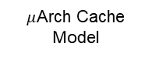
Executive Summary
Observed memory access latency
RL Agent
Environment
We use RL to automatically explore cache timing attacks in processors
We find attacks on a diverse configurations of caches
Different replacement policies
Different defense mechanisms
We discover StealthyStreamline attacks
Bypass performance counter-based detection
Higher bandwidth
a_{x}: attacker
access
attacker process
a_{v}: trigger victim
access
victim process
Memory
State
Action
addr_{secret}
Cache
a_{g}: guess
addr_{secret}
guess evaluator
$μ$Arch Cache Model
DNN Model
Reward
New attack patterns
4
0 | 1 | 2 | 3 | v? | 4
0 | 1

Slide 39
Prior Work on ML for Side Channel
Focuses on using ML to analyze existing power side-channel traces and predict secrets
Use a supervised learning model to analyze traces
Auto-encoder to learn representations

